Slide 1
7151CEM: Computing Individual Research Project : Drug-Drug Interaction Prediction Using Machine Learning and Deep Learning Models.
Anantha Navya Kalyani (ID: 14597727)
MSc. Data Science and Computational Intelligence
Coventry University, Coventry, United Kingdom
ananthan2@coventry.ac.uk

Slide 2

Drug-Drug Interaction Prediction Using Machine Learning and Deep Learning Models.

Slide 3
Motivation
Why predicting DDIs is crucial:
- Prevent adverse interactions, reducing side effects and life-threatening conditions.
- Improve patient safety by minimizing risks of harmful drug interactions.
- Aid drug development by identifying potential interactions early in the pipeline.

Slide 4
Problem Statement
Predicting drug-drug interactions (DDIs) is complex due to the intricate nature of biological systems.
Adverse interactions can lead to harmful or life-threatening conditions, impacting patient safety.
Existing methods often lack interpretability and scalability, making it challenging to predict interactions accurately.

Slide 5
Research Questions (
How can machine learning models be used to predict drug-drug interactions (DDIs) based on protein and drug embeddings?
Investigating the potential of embedding techniques to represent complex biological interactions.
What are the key features from drug-target relationships that contribute to accurate DDI prediction?
Exploring the biological features (e.g., protein targets, binding affinities) that impact DDI outcomes.
Which machine learning models provide the best accuracy and generalization for DDI prediction?
Comparing traditional models (Random Forest, XGBoost) with deep learning approaches (Neural Networks, CNNs) for DDI prediction.
How can class imbalance in DDI datasets be addressed to improve model performance?
Evaluating methods like SMOTE to balance the distribution of positive and negative interactions.
What is the impact of dimensionality reduction techniques on DDI prediction models?
Investigating whether techniques like TruncatedSVD improve model efficiency without losing predictive power.

Slide 6
Project Objectives
Develop a Predictive Framework:
Build a machine learning model to classify drug pairs as interacting or non-interacting.
Use Biologically Meaningful Features:
Generate embeddings from protein sequences and drug-target relationships to represent drugs and their interactions.
Ensure Scalability and Efficiency:
Optimize models like Random Forest, Gradient Boosting, and Neural Networks for large datasets.
Improve Data Quality:
Clean datasets, balance class distributions, and standardize features for reliable predictions.
Enable Practical Applications:
Provide insights to support safer drug administration and streamline drug development processes.

Slide 7
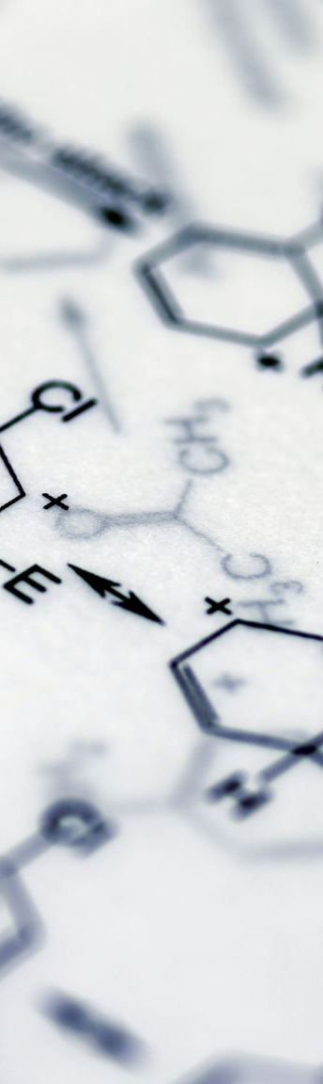
Literature Review
BioBERT (Lee et al., 2020):
BioBERT is a transformer-based model pre-trained on biomedical text, excelling in tasks like named entity recognition and relation extraction. It has proven effective for processing biomedical data, such as protein sequences, in DDI prediction.
Multimodal CNN-DDI (Zhang et al., 2020):
This study uses a multimodal CNN to predict drug-drug interaction events by integrating drug molecular features and interaction data, significantly improving DDI prediction accuracy.
Deep Learning for DDI Prediction (Choi & Cho, 2020):
This approach utilizes deep learning models combined with protein-protein interaction networks to enhance DDI prediction by capturing molecular relationships.
Network Integration for DDI Prediction (Yu et al., 2021):
This research integrates drug, target, and side effect networks to predict DDIs, demonstrating the effectiveness of combining multi-source data for more accurate predictions.

Slide 8
Data Sources
DrugBank:
Provides comprehensive drug-target mappings, including drug IDs, target proteins, and interaction labels.
Key resource for extracting drug_targets.csv and ddi_labels.csv.
UniProt/NCBI:
Repository of protein sequences, offering detailed structural and functional information.
Used to extract protein sequences in FASTA format for embedding generation.
Key Data Files:
drug_targets.csv: Maps drugs to their associated target proteins.
ddi_labels.csv: Contains labeled drug pairs for interaction classification.
protein_sequences.fasta: Stores protein sequences for embedding generation.
Purpose:
Integrating these datasets ensures biologically relevant and high-quality input features for DDI prediction.

Slide 9
Dataset Cleaning
Objective:
Ensure consistency, accuracy, and balance across datasets to improve model reliability.
Steps:
Remove Duplicates & Missing Entries: Eliminated redundant drug-target mappings and incomplete protein sequences.
Filter Protein Sequences: Retained only the sequences required by drug_targets.csv.
Balance Interaction Labels: Applied SMOTE to achieve a 50/50 distribution of positive and negative labels in ddi_labels.csv.
Results:
Drug Targets: Reduced from 22,414 to 22,392.
Protein Sequences: Reduced from 4,906 to 4,900.
Balanced DDI Labels: Achieved 50.05% positive and 49.95% negative.
Impact:
High-quality datasets ensure robust feature engineering and model training.

Slide 10
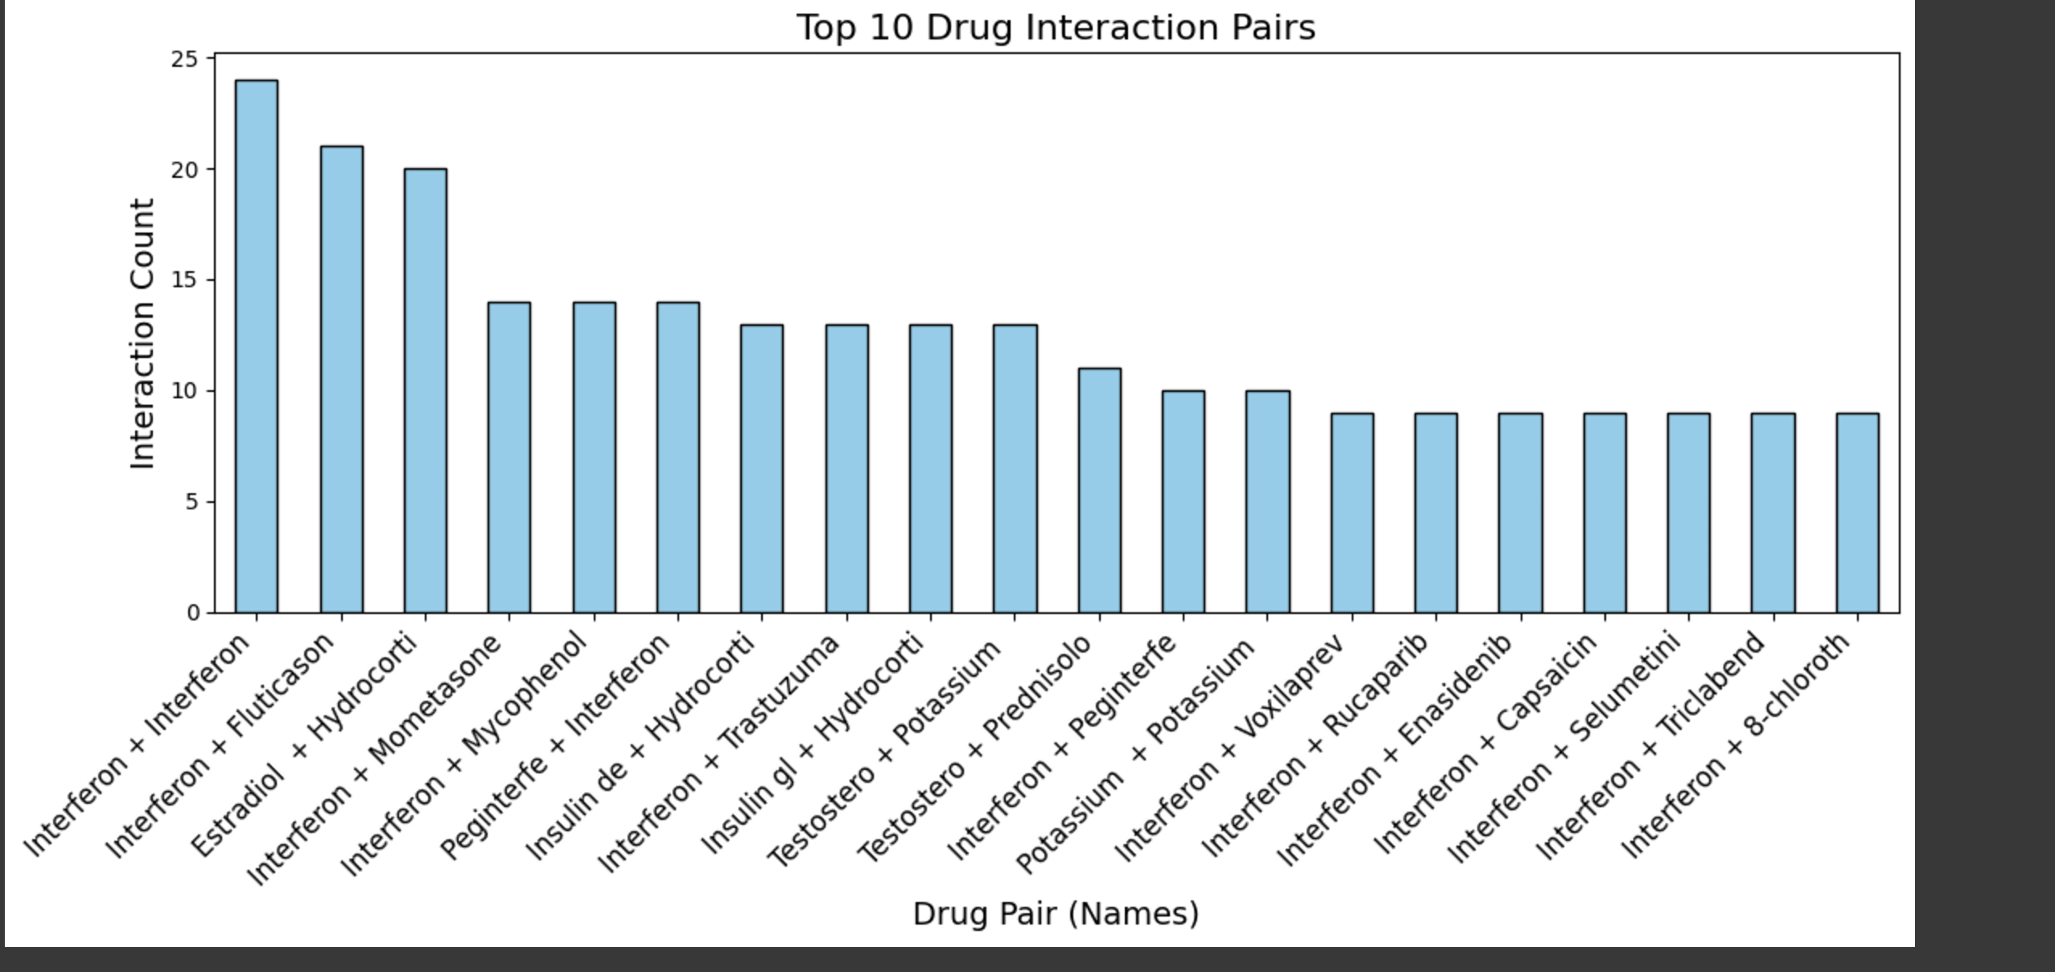

Slide 11
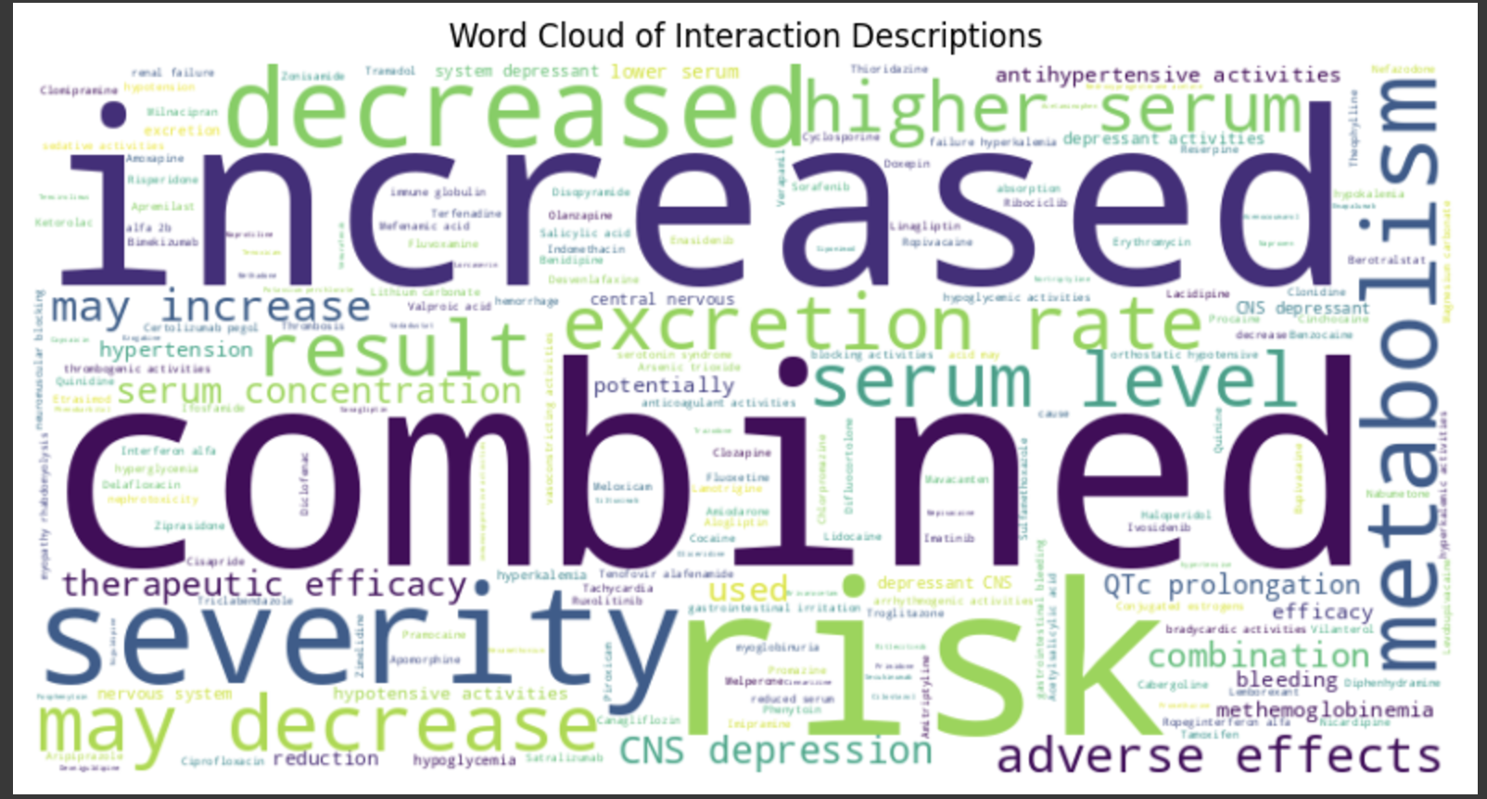

Slide 12
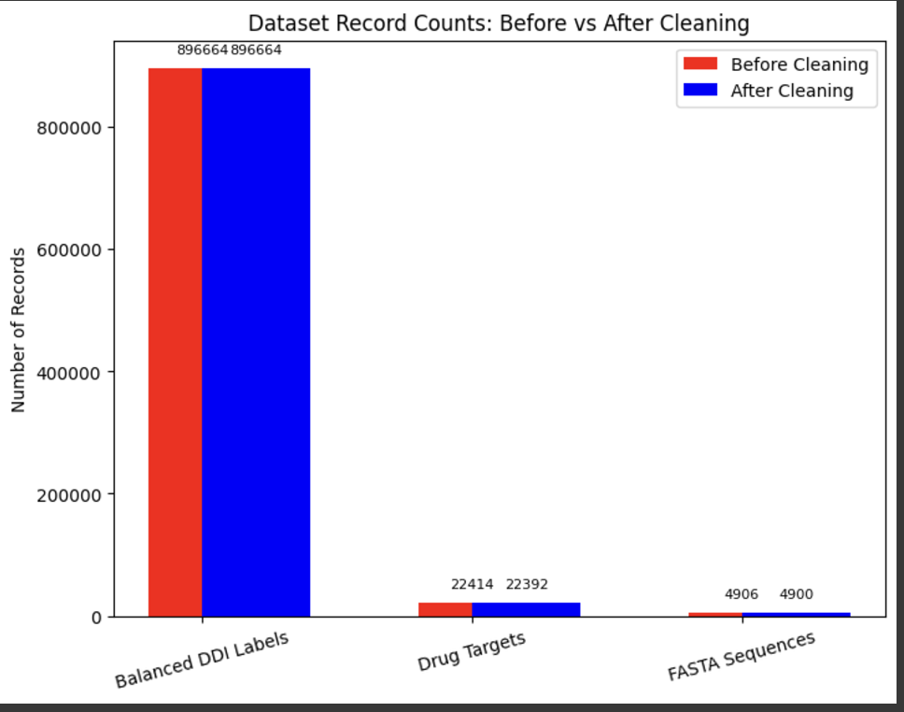

Slide 13
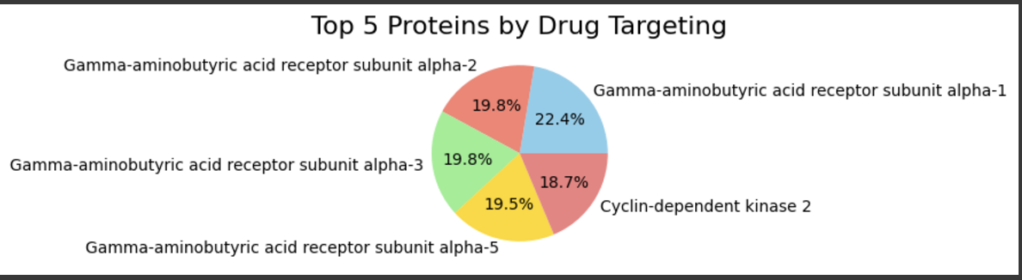
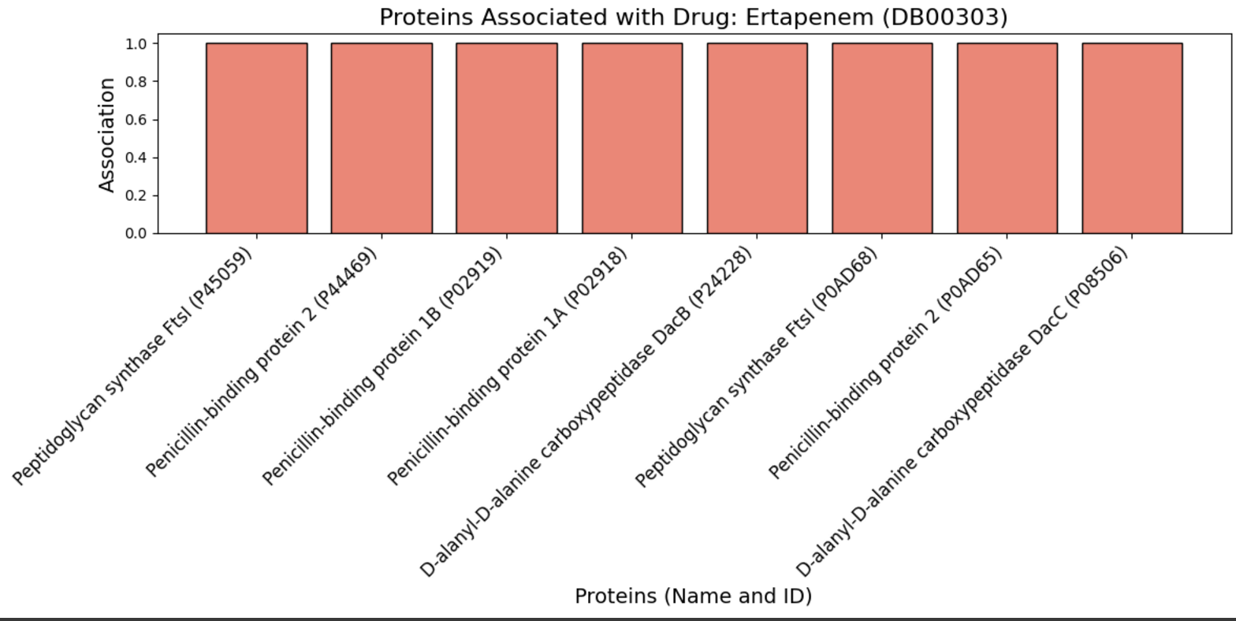

Slide 14
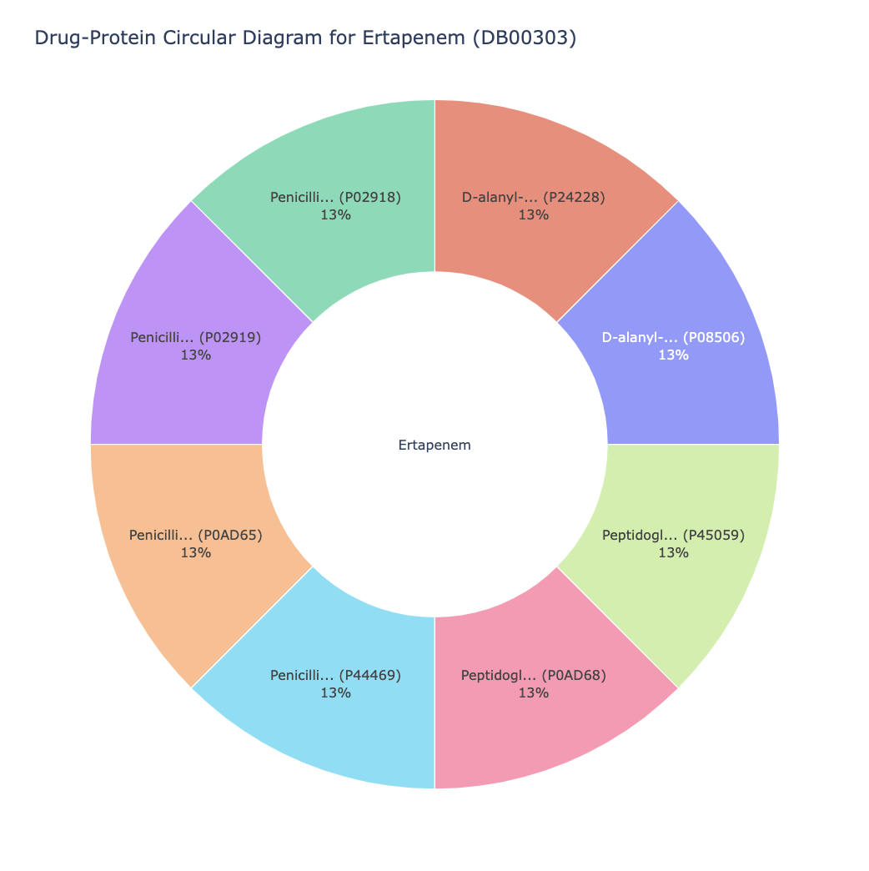

Slide 15
Balanced Class Distribution
Objective:
Ensure equal representation of positive and negative interaction labels to prevent model bias.
Before Balancing:
Class 1 (Positive Interactions): 448,332 (50.05%)
Class 0 (Negative Interactions): 447,352 (49.95%)
Balancing Method:
Applied SMOTE (Synthetic Minority Oversampling Technique) to generate synthetic samples for the minority class.
After Balancing:
Class 1: 314,236 (50%)
Class 0: 314,236 (50%)
Total Samples: 628,472
Impact:
Balanced dataset improves model accuracy and helps predict both interacting and non-interacting drug pairs more reliably.

Slide 16
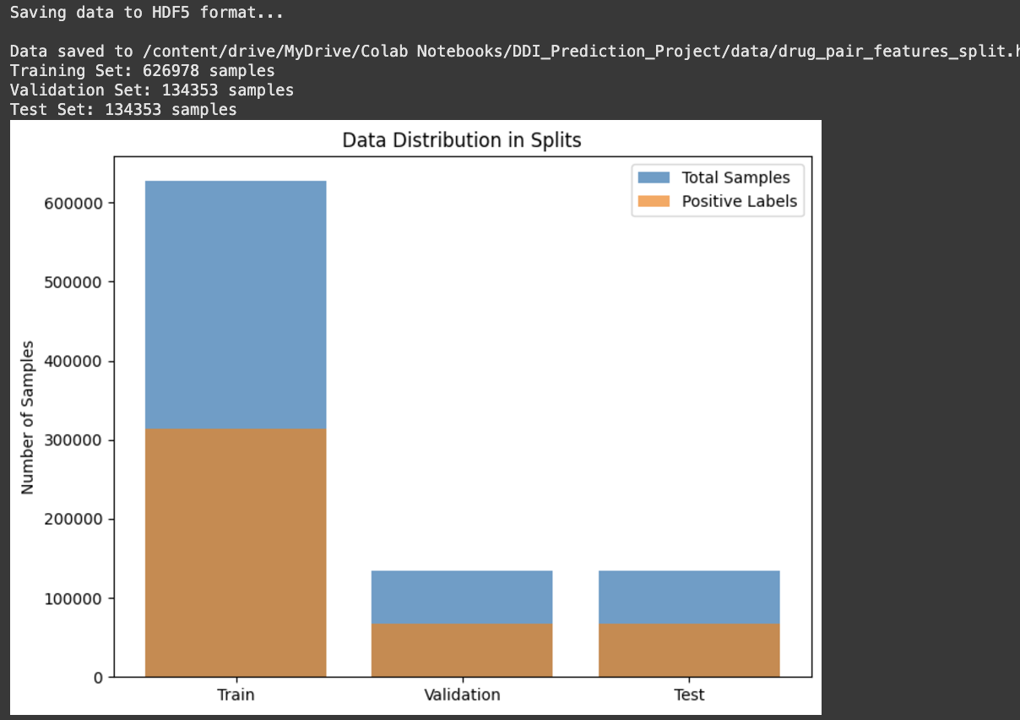

Slide 17
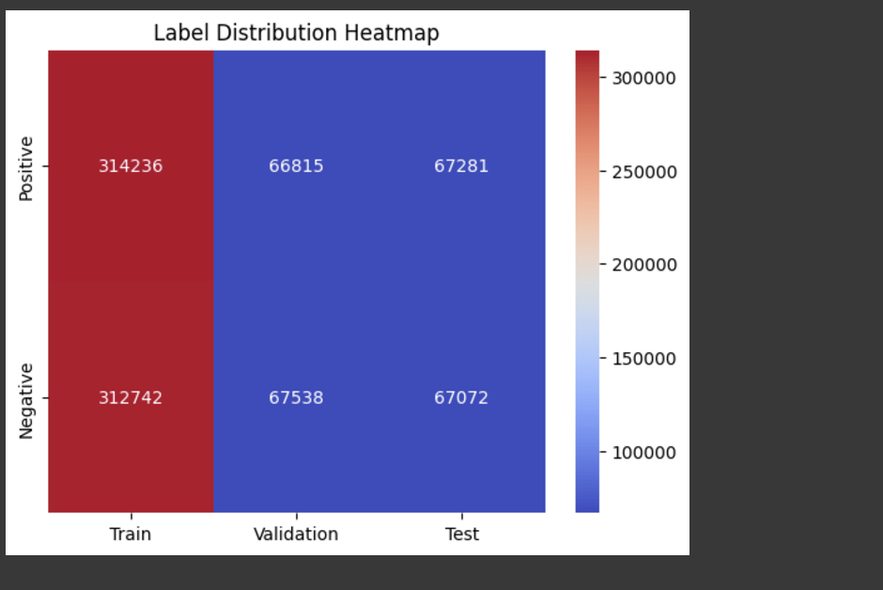

Slide 18
Key Statistics
Dataset Overview:
Total Drugs: 7,793
Total Proteins: 4,900
Drug-Protein Relationships: 22,392
Total Drug Pairs: 895,684
Class Distribution:
Positive Interactions: 448,332 pairs (50.05%)
Negative Interactions: 447,352 pairs (49.95%)
Embedding Dimensions:
Protein Embeddings: 1,024 dimensions (generated using ProtBERT).
Drug Embeddings: Aggregated protein embeddings (1,024 dimensions).
Drug Pair Features: 2,048 dimensions (concatenated embeddings).
Final Dataset for Training:
Training Samples: 626,978 (70%)
Validation Samples: 134,353 (15%)
Test Samples: 134,353 (15%)
Purpose:
This rich dataset ensures biologically meaningful and scalable inputs for predictive modeling.

Slide 19
Pipeline Overview
Step 1
1
Data Cleaning
Remove duplicates, handle missing data, and filter relevant protein sequences.
Balance interaction labels using SMOTE.
Step 2
2
Protein Embeddings
Generate 1,024-dimensional embeddings using ProtBERT for protein sequences.
Step 3
3
Drug Embeddings
Aggregate protein embeddings for each drug to form a single 1,024-dimensional vector.
Step 4
4
Drug Pair Feature Creation
Concatenate drug embeddings to create 2,048-dimensional feature vectors for each drug pair.
Step 5
5
Data Splitting
Split the dataset into training (70%), validation (15%), and test (15%) sets.
Step 6
6
Feature Scaling
Standardize features using StandardScaler.
Step 7
7
Dimensionality Reduction
Apply TruncatedSVD to reduce features from 2,048 to 200 dimensions.
Step 8
8
Model Training
Train models (Random Forest, Gradient Boosting, XGBoost, NN, CNN) using tuned hyperparameters.
Step 9
Evaluation
Evaluate models using accuracy, F1 score, precision, and recall.

Slide 20
Protein Embeddings
Purpose:
Capture structural and functional properties of proteins to serve as input features for drug-target interactions.
Method Used:
ProtBERT Model:
A transformer-based model trained on protein sequences.
Generates embeddings that capture sequence patterns and biological significance.
Embedding Details:
Input: Protein sequences in FASTA format.
Output: Fixed-length 1,024-dimensional embeddings for each protein.
Total Proteins Embedded: 4,900 sequences.
Example:
Protein ID: P12345
Sequence: "MKTAYIAKQRQISFVKSHFSRQDILDLWQTY..."
Embedding Shape: (1,024)
Impact:
Provides biologically meaningful representations to improve the accuracy of DDI prediction models.

Slide 21
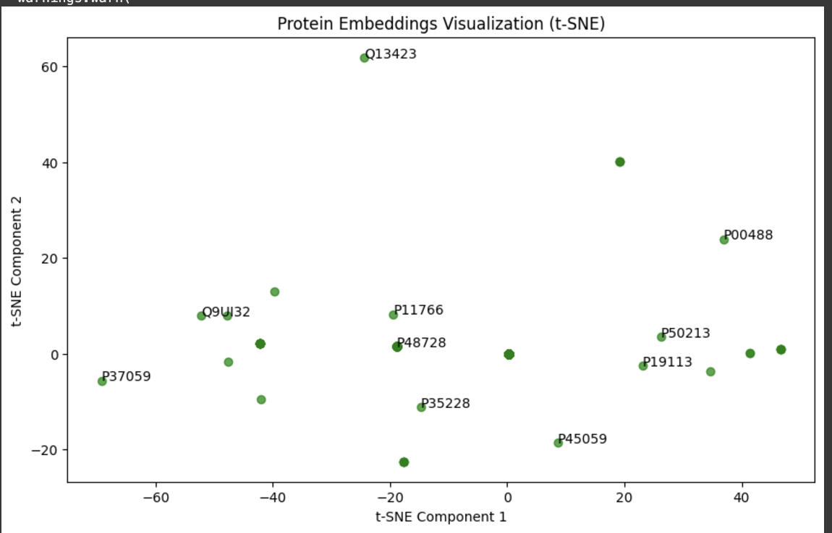

Slide 22
Drug Embeddings
Purpose:
Represent each drug as a single embedding by aggregating the embeddings of its associated target proteins.
Method Used:
Aggregation of Protein Embeddings:
For each drug, the embeddings of its target proteins are mean-pooled to create a single fixed-length vector.
Embedding Details:
Input: Protein embeddings generated using ProtBERT.
Output: Fixed-length 1,024-dimensional embeddings for each drug.
Total Drugs Embedded: 7,793 drugs.
Example:
Drug ID: DB12345
Target Proteins: P12345, P67890, P54321
Aggregated Embedding Shape: (1,024)
Key Benefits:
Encodes information about the drug's mechanism of action and pharmacological properties.
Enables comparison between drugs based on shared or similar targets.
Impact:
Forms the foundation for creating drug pair features, enabling robust DDI prediction.

Slide 23
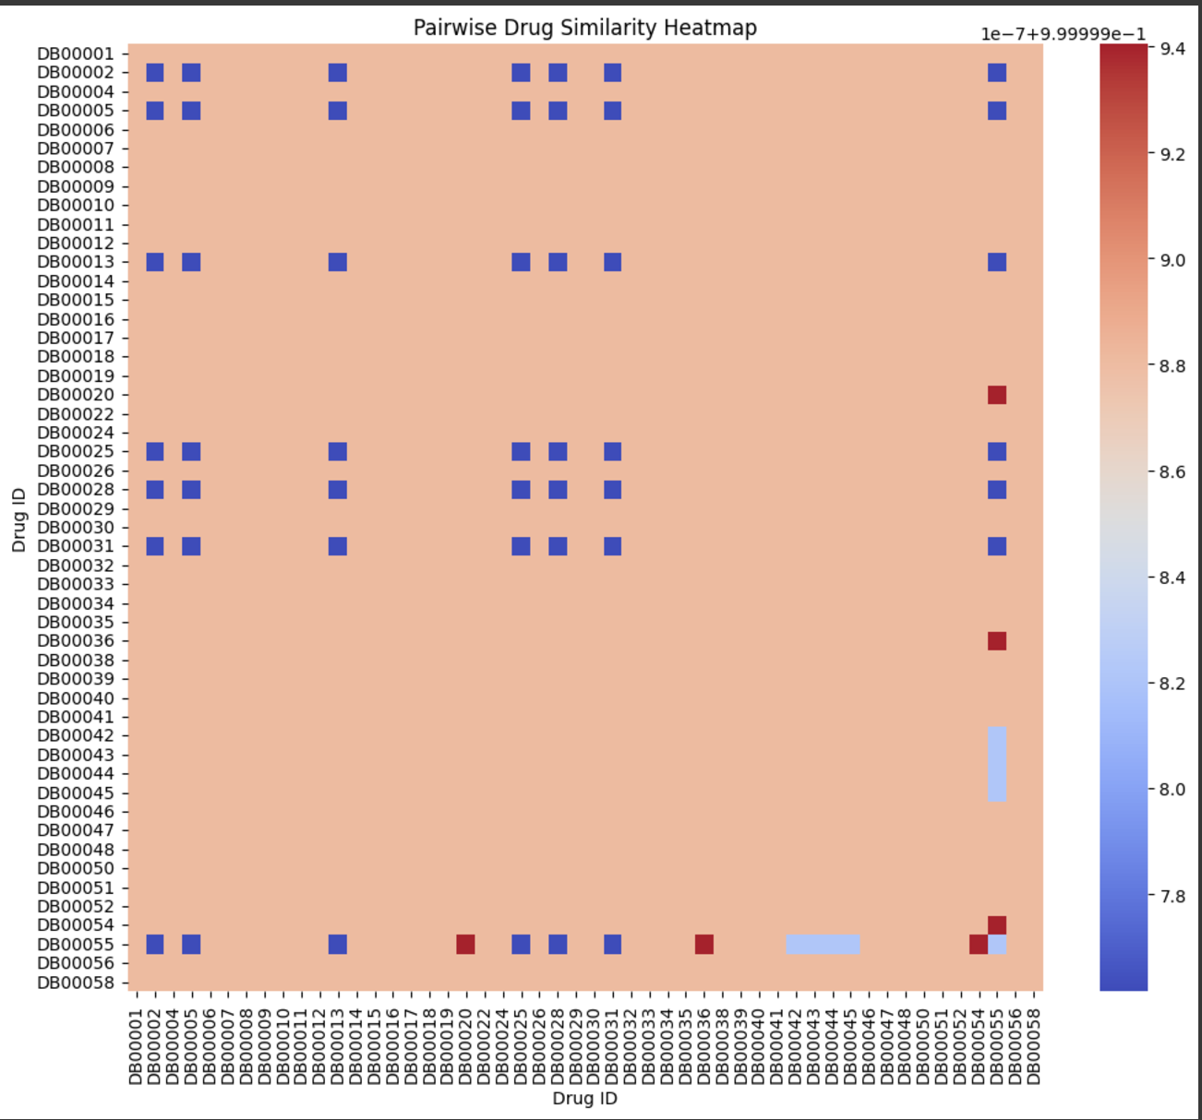

Slide 24
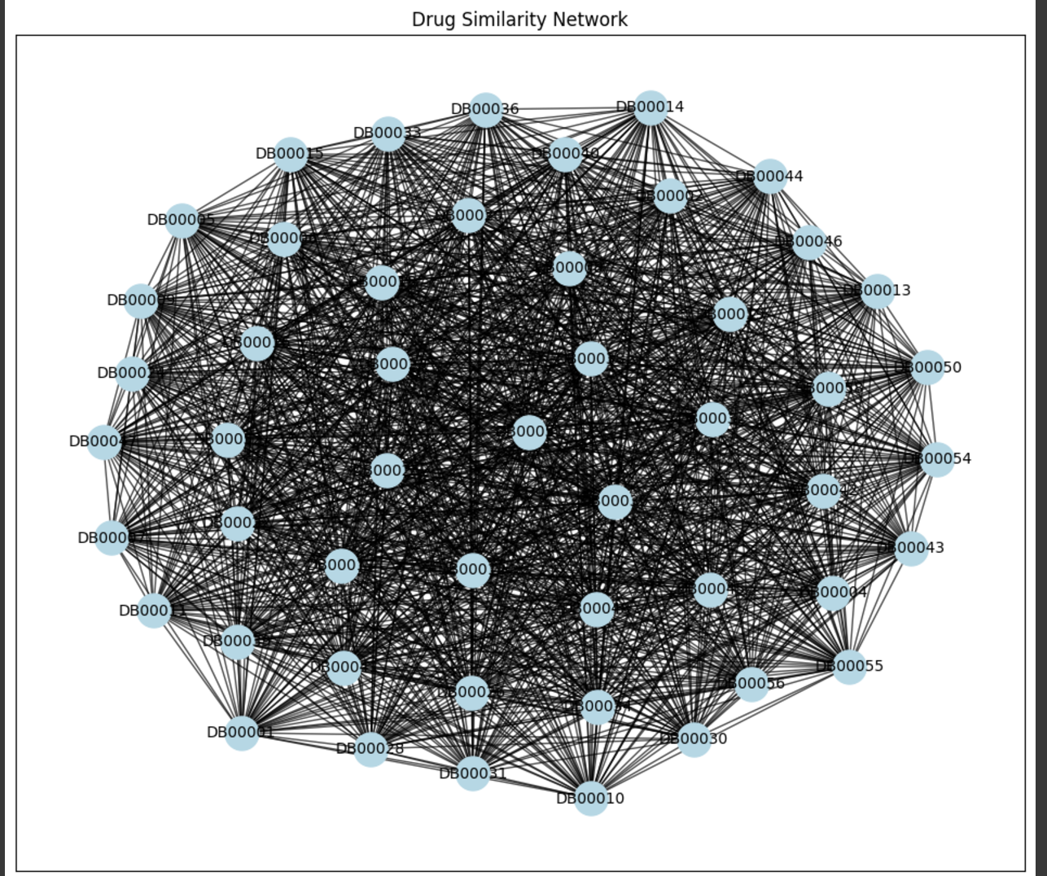

Slide 25
Drug Pair Features
Purpose:
Represent the relationship between two drugs by combining their embeddings, enabling machine learning models to learn interaction patterns.
Method Used:
Concatenation:
Drug embeddings (1,024 dimensions each) are concatenated to create a single feature vector for each drug pair.
Resulting Feature Vector: 2,048 dimensions.
Feature Creation Process:
Generate drug embeddings for each drug using aggregated protein embeddings.
For each pair of drugs, concatenate their embeddings to form a unified feature vector.
Key Benefits:
Captures similarity, complementarity, and interaction potential between drugs based on their target profiles.
Enables the model to differentiate between interacting and non-interacting drug pairs.
Example:
Drug A (DB12345): 1,024-dimensional embedding.
Drug B (DB67890): 1,024-dimensional embedding.
Drug Pair Feature Vector: 2,048 dimensions.
Impact:
Provides a high-dimensional, information-rich representation for robust DDI classification.

Slide 26
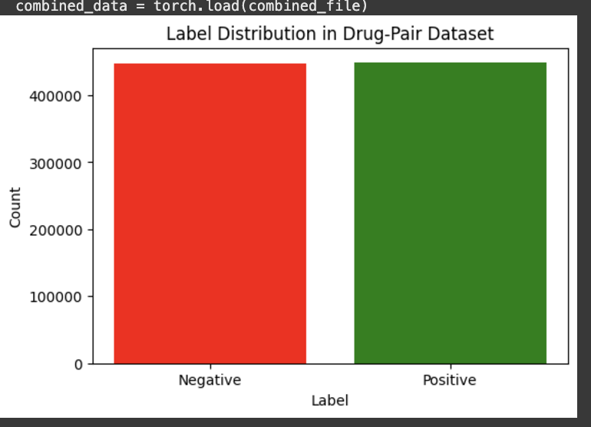

Slide 27
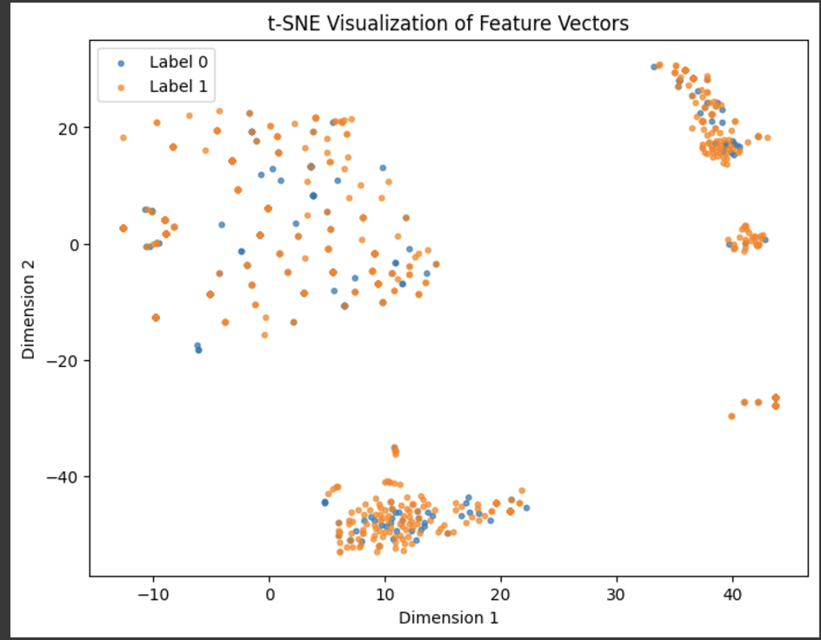

Slide 28
Feature Scaling
Purpose:
Normalize feature values to ensure all features contribute equally to the model and prevent bias caused by varying feature magnitudes.
Method Used:
StandardScaler:
Transforms each feature to have a mean of 0 and a standard deviation of 1.
Process:
Compute Scaling Parameters:
Calculated mean and standard deviation for each feature using the training data.
Apply Scaling:
Transformed the training, validation, and test datasets using the computed scaling parameters.
Chunked Processing:
Applied scaling in chunks to handle memory constraints for large datasets.
Impact:
Ensures features are on the same scale, improving:
Model convergence speed during training.
Consistency in distance-based calculations (e.g., gradient computations).
Example:
Before Scaling: Feature ranges vary widely, e.g., [0.01, 1000].
After Scaling: Feature values transformed to a uniform scale, e.g., [-1.5, 1.5].

Slide 29
Dimensionality Reduction
Purpose:
Reduce the high-dimensional feature vectors (2,048 dimensions) to a smaller, computationally efficient size while retaining most of the variance.
Method Used:
Truncated Singular Value Decomposition (TruncatedSVD):
A dimensionality reduction technique that preserves linear relationships and significant variance in the data.
Reduced feature vectors to 200 dimensions, retaining ~90% of the original variance.
Process:
Input: 2,048-dimensional feature vectors (drug pair features).
Apply TruncatedSVD to extract 200 most important components.
Output: Reduced-dimensional feature vectors for all drug pairs.
Key Benefits:
Reduces computational cost for model training.
Mitigates overfitting by eliminating redundant or irrelevant features.
Enhances model performance and scalability.

Slide 30
Model Development
Objective
Build and evaluate machine learning models to classify drug pairs as interacting or non-interacting.
Models Evaluated
Random Forest, Gradient Boosting, XGBoost, Neural Network, CNN
Pipeline Steps
Data balanced using SMOTE and standardized with StandardScaler.
Feature reduction via TruncatedSVD (200 dimensions).
Hyperparameter tuning with GridSearchCV.
Evaluation Metrics
Accuracy, F1 Score, Precision, Recall
Results Summary
Best Model: Random Forest (64.89% accuracy).
Deep learning models underperformed due to dataset size and overfitting.
Impact
Traditional models (e.g., Random Forest) outperformed neural networks.
Engineered features led to better results than deep learning.

Slide 31
SMOTE
Purpose:
Address class imbalance by creating synthetic samples for the minority class, ensuring equal representation of positive and negative interaction labels.
Process:
Identified imbalanced classes in the training data:
Positive Interactions (Class 1): 314,236 samples.
Negative Interactions (Class 0): 312,742 samples.
Applied SMOTE to generate synthetic samples for the minority class by interpolating between existing samples.
Resulted in a balanced dataset with equal class distribution.
Class Distribution:
Before SMOTE:
Positive Interactions: 50.05%
Negative Interactions: 49.95%
After SMOTE:
Positive Interactions: 50%
Negative Interactions: 50%
Impact:
Prevents model bias toward the majority class, improving predictive performance for the minority class (positive interactions).

Slide 32
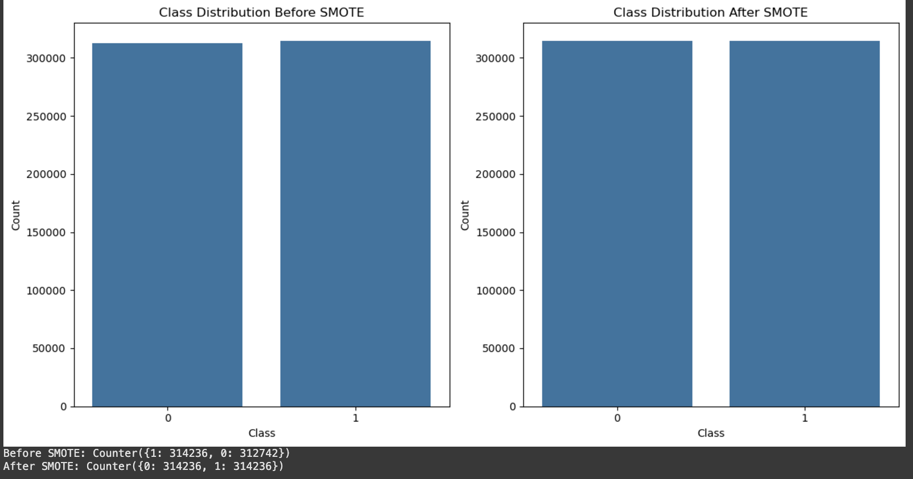

Slide 33
Hyperparameter Tuning for All Models
Model | Best Parameters
Random Forest | n_estimators=500, max_depth=10, min_samples_split=5, min_samples_leaf=2
Gradient Boosting | n_estimators=200, learning_rate=0.01, max_depth=5
XGBoost | n_estimators=500, learning_rate=0.01, max_depth=5
Neural Network | Batch size: 32, Learning rate: 0.001, Epochs: 50
CNN | Filters: [16, 32], Kernel size: 3x3, Learning rate: 0.001, Epochs: 1

Slide 34
Training Performance
Evaluate the performance of all models using metrics like accuracy, F1 score, precision, and recall on the test dataset.
Model | Accuracy | F1 Score | Precision | Recall
Random Forest | 64.89% | 59.01% | 71.02% | 50.00%
Gradient Boosting | 64.87% | 59.04% | 71.03% | 50.01%
XGBoost | 64.88% | 59.01% | 71.02% | 50.00%
Neural Network | 61.84% | 59.04% | 70.63% | 35.00%
CNN | 56.03% | 58.93% | 70.42% | 17.00%

Slide 35
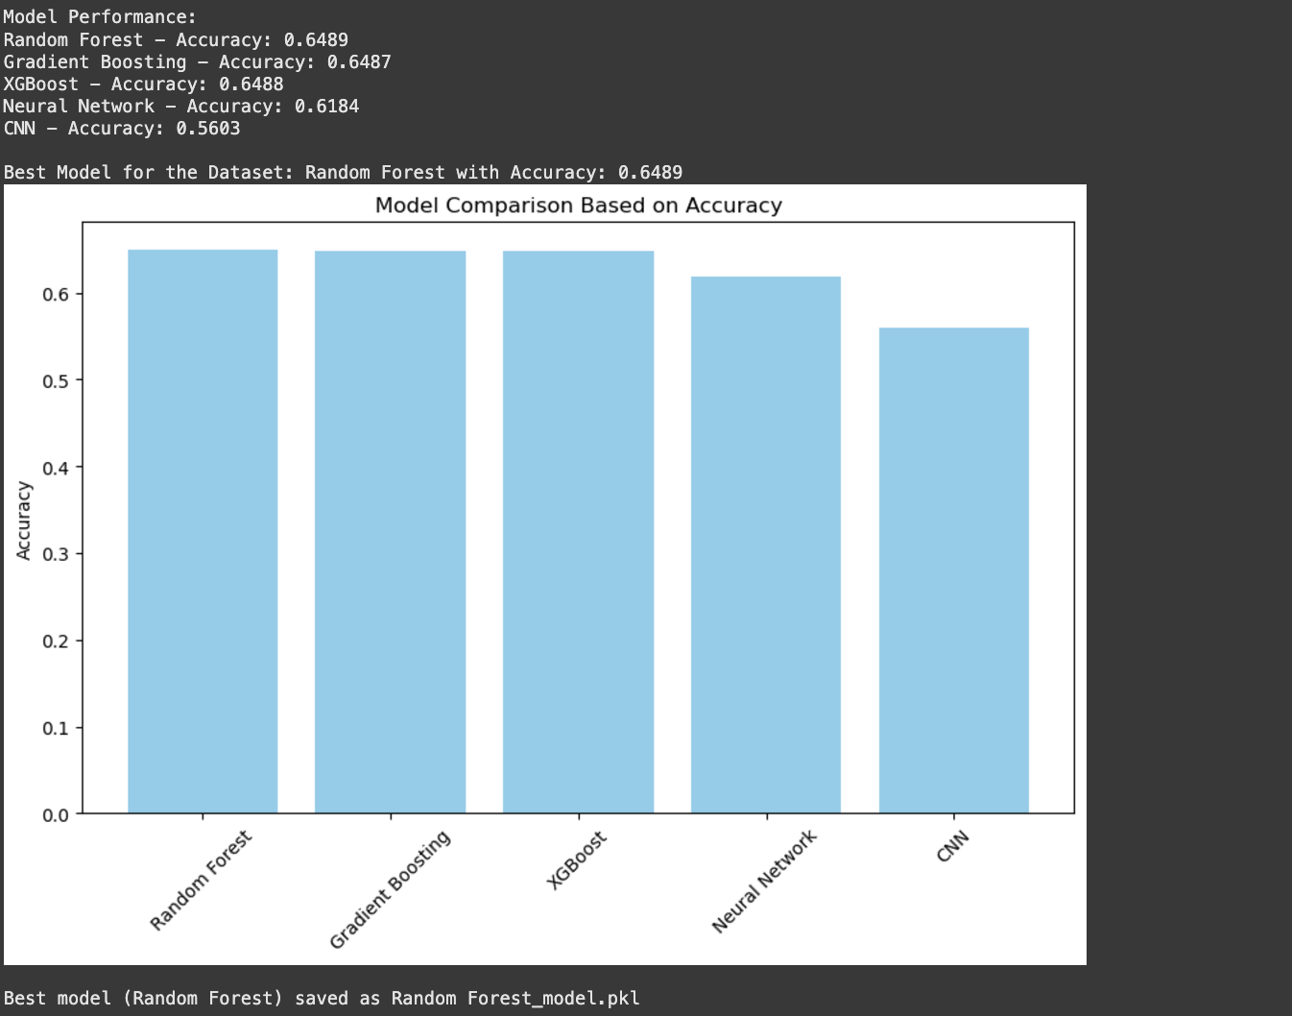

Slide 36
Key Observations:
Random Forest: Best overall performance with the highest accuracy and F1 score.
Gradient Boosting & XGBoost: Comparable performance, slightly behind Random Forest.
Neural Network: Struggled with recall due to limited data and overfitting issues.
CNN: Lowest performance, indicating the need for more advanced architectures or data.

Slide 37
Dimensionality Reduction Impact
Model | Accuracy (Before SVD) | Accuracy (After SVD) | Impact
Random Forest | 65.20% | 64.89% | Negligible drop
Gradient Boosting | 65.10% | 64.87% | Negligible drop
XGBoost | 65.18% | 64.88% | Negligible drop
Neural Network | 62.12% | 61.84% | Minor drop
CNN | 56.50% | 56.03% | Minor drop
Objective:Evaluate how reducing feature dimensions from 2,048 to 200 using TruncatedSVD impacted model performance.

Slide 38
Key Insights:
Performance Retention:
Most models retained similar accuracy, showing that SVD preserved essential variance (~90%).
Reduced Computational Cost:
Training time and memory usage significantly decreased after dimensionality reduction.
Overfitting Mitigation:
Removing redundant features helped mitigate overfitting in some models.
Impact:
Dimensionality reduction improved model scalability without significantly affecting accuracy or F1 scores.
Enabled faster experimentation and tuning for all models.

Slide 39
Model Comparisons
Performance metrics of all models.
Model | Accuracy | F1 Score | Precision | Recall
Random Forest | 64.89% | 59.01% | 71.02% | 50.00%
Gradient Boosting | 64.87% | 59.04% | 71.03% | 50.01%
XGBoost | 64.88% | 59.01% | 71.02% | 50.00%
Neural Network | 61.84% | 59.04% | 70.63% | 35.00%
CNN | 56.03% | 58.93% | 70.42% | 17.00%
Best Model: Random Forest with the highest accuracy and balanced F1 score.
Traditional Models (Random Forest, Gradient Boosting, XGBoost):Consistently outperformed Neural Network and CNN.
Deep Learning Models (NN, CNN):Struggled due to overfitting and limited dataset size.

Slide 40
Best Model: Random Forest
Why Random Forest?
Achieved the highest accuracy and F1 score among all models.
Performed well on both interacting (Class 1) and non-interacting (Class 0) drug pairs.
Robust to overfitting due to ensemble learning.
1. Performance Metrics:
Accuracy: 64.89%
F1 Score: 59.01%
Precision: 71.02%
Recall: 50.00%
2. Best Hyperparameters:
n_estimators: 500
max_depth: 10
min_samples_split: 5
min_samples_leaf: 2

Slide 41
Feature Importance
Feature | Importance Score
Protein Target 1 | 0.15
Protein Target 2 | 0.13
Drug Pair Similarity 1 | 0.12
Binding Affinity 1 | 0.10
Drug Mechanism 1 | 0.09
Protein Interaction 1 | 0.08
Binding Site 2 | 0.08
Drug Structure 1 | 0.07
Drug Mechanism 2 | 0.06
Protein Interaction 2 | 0.05
Top 10 important features identified using Random Forest.

Slide 42

Deep Learning Challenges
Dataset Limitations
Small dataset size led to overfitting and poor generalization.
High Computational Cost
Required significant resources for training large feature vectors.
Overfitting Issues
High variance between training and validation performance.
Feature Challenges
Concatenated embeddings lacked complex spatial patterns for CNNs.
Performance Gap
NN and CNN underperformed compared to Random Forest and Gradient Boosting.

Slide 43
Interpretation of Results
Best Model: Random Forest
Achieved the highest accuracy (64.89%) and balanced F1 score.
Demonstrated robustness and interpretability in identifying drug-drug interactions.
Traditional Models vs. Deep Learning:
Random Forest, Gradient Boosting, XGBoost:
Performed consistently well with engineered features and balanced data.
Neural Network (NN) & CNN:
Struggled due to dataset size and overfitting, highlighting the need for larger datasets or tailored architectures.
Feature Importance:
Protein target and drug mechanism features played a critical role in predictions.
Aggregated embeddings successfully captured biological relevance.
Dimensionality Reduction:
TruncatedSVD retained ~90% variance with negligible performance impact, improving computational efficiency.
Class Imbalance Addressed:
SMOTE balanced the dataset, enhancing recall for the minority class (positive interactions).
Key takeaway: Traditional models provided a balance of performance and interpretability, outperforming deep learning approaches given the dataset constraints.

Slide 44
Key Takeaways
Best Model:
Random Forest outperformed other models with the highest accuracy (64.89%).
Feature Importance:
Protein target and drug mechanism features were crucial for accurate DDI prediction.
Deep Learning Challenges:
Neural Networks and CNNs struggled due to limited dataset size and overfitting.
Dimensionality Reduction Impact:
TruncatedSVD reduced feature dimensions to 200, retaining most of the variance with minimal performance loss.
Class Imbalance:
SMOTE helped balance the dataset, improving model recall for positive interactions.
Scalability & Efficiency:
Traditional models provided a good balance of performance and efficiency compared to deep learning models.

Slide 45
Limitations
Small Dataset:
Led to overfitting in deep learning models (NN, CNN).
Overfitting:
Neural Networks and CNNs struggled with high variance.
Interpretability:
Deep learning models lack transparency compared to Random Forest.
Computational Cost:
Deep learning models require significant resources.
Class Imbalance:
Despite SMOTE, achieving perfect recall for positive interactions is challenging.

Slide 46
Future Improvements
Larger Datasets:
Train deep learning models with more data to reduce overfitting.
Advanced Architectures:
Use transformer-based models for better feature extraction.
Ensemble Methods:
Combine Random Forest, Gradient Boosting, and XGBoost for improved accuracy.
Enhanced Features:
Add molecular descriptors and drug similarity scores.
Real-World Application:
Apply the model in clinical settings for DDI prediction.

Slide 47

Applications
Clinical Safety:
Predict potential drug-drug interactions to prevent adverse effects and enhance patient safety.
Drug Development:
Identify safe drug combinations and optimize treatment regimens during drug discovery.
Personalized Medicine:
Tailor drug prescriptions based on predicted interactions for individual patients.
Regulatory Approval:
Assist pharmaceutical companies in submitting interaction data to regulatory bodies like the FDA.
Pharmacovigilance:
Monitor and predict DDIs post-market to ensure ongoing drug safety.
Goal:
Apply the model to improve drug safety, treatment efficacy, and patient care.

Slide 48
Acknowledgments and References
Lee, J., Yoon, W., Kim, S., Kim, D., & So, C. H. (2020). BioBERT: A pre-trained biomedical language representation model for biomedical text mining. Bioinformatics, 36(4), 1235-1242. https://doi.org/10.1093/bioinformatics/btz682
Zhang, L., Liu, Z., & Zhang, Y. (2020). Multimodal CNN-DDI: Using multimodal CNN for drug-to-drug interaction associated events. Journal of Biomedical Informatics, 108, 103521. https://doi.org/10.1016/j.jbi.2020.103521
Choi, J., & Cho, S. (2020). Deep learning-based drug-drug interaction prediction using protein-protein interaction networks. Bioinformatics, 36(5), 1506-1512. https://doi.org/10.1093/bioinformatics/btz832
Yu, H., Wang, L., & Zhang, L. (2021). Drug-drug interaction prediction via integration of drug, target, and side effect networks. IEEE Transactions on Neural Networks and Learning Systems, 32(5), 2210-2221. https://doi.org/10.1109/TNNLS.2020.3033898

Slide 49
Thank you

